Slide 1

Agricultural products Rural Entrepreneurship Management System
2200031433-O.Sirisha
2200032788-S Lakhsmi Lalasa
2200032874-A Meghan Kumar

Slide 2
Contents
Problem Statement
Abstract
Introduction
Users of the project
Modules
Customer Journey Map
Survey
Frameworks and Tools
Conclusion

Slide 3
Problem Statement
The project aims to support farmers by enabling them to create and sell value-added agricultural products, helping promote rural entrepreneurship. The web app will connect farmers with global buyers, simplifying transactions, improving market access, and encouraging technological adoption.

Slide 4
Abstract
This project focuses on building a web application that transforms the agricultural landscape by supporting farmers in turning their crops into valuable goods. Through this platform, farmers can list products, manage inventory, and reach a global audience, while buyers can easily access and purchase these products. Admins will manage users, transactions, and platform maintenance, ensuring a smooth workflow for all users.

Slide 5
Introduction
In today’s global market, farmers struggle to sell raw produce at fair prices. By converting crops into value-added products like processed foods or handmade goods, they can boost their income and diversify revenue streams. This project empowers farmers to explore entrepreneurship, connect with global buyers, and promote rural development. By leveraging technology, it enhances product quality, market access, and financial stability, fostering innovation and economic growth in rural areas.

Slide 6
Users of the Project
Admin: Manages the platform, overseeing user accounts, monitoring transactions, and ensuring the app's smooth functioning.
Farmer: Lists and sells products, manages inventory, and interacts with buyers.
Buyer: Browses listed products, places orders, and provides feedback on purchases.

Slide 7
Modules
Admin Module:
User Management: Admins can create, modify, or delete user accounts (farmers, buyers) and ensure the smooth functioning of the platform.
Transaction Oversight: Admins monitor transactions, resolving any issues or disputes between farmers and buyers.
Platform Maintenance: Admins manage platform features, content, and security, ensuring the app runs efficiently.

Slide 8
Farmer Module
Registration/Login: Farmers create accounts or log in with unique credentials and go through a secure validation process.
Product Listing: Farmers can list their value-added agricultural products with descriptions, prices, and images.
Inventory Management: Farmers can track stock levels and update product availability and pricing.
Buyer Interaction: Farmers receive and manage buyer inquiries and order details, facilitating smooth communication.
Order Fulfillment: Farmers track and update the status of orders from preparation to delivery.

Slide 9
Buyer Module
Registration/Login: Buyers create accounts or log in securely with unique credentials.
Product Browsing: Buyers can search and filter through listed products using various criteria like categories and price ranges.
Order Placement: Buyers use an intuitive interface for product selection, with options for customization and real-time price updates.
Payment: Secure online payment gateways are integrated, with the ability to save payment information for future use.
Order Confirmation: Buyers receive order confirmations and progress notifications via email or push notifications.
Order History: Buyers can access their past orders for reordering and can save preferences for a personalized shopping experience.

Slide 10
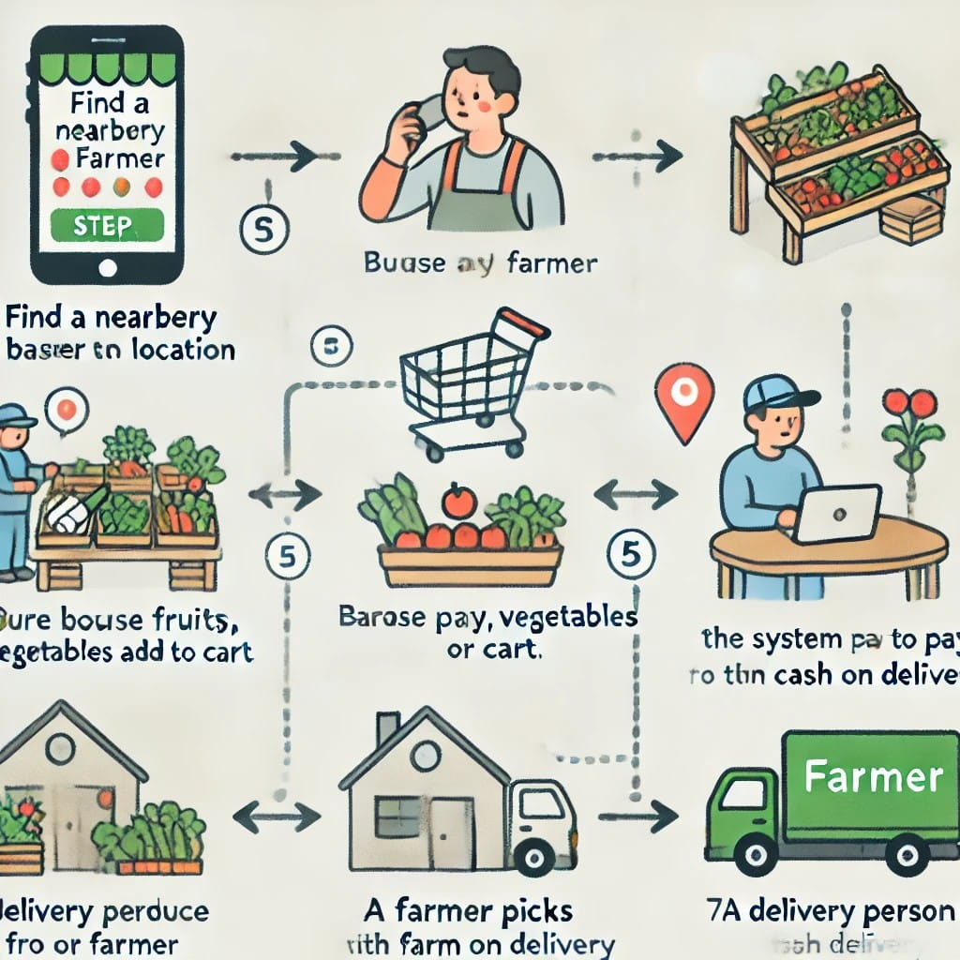
Customer Journey Map

Slide 11
Survey

Slide 12
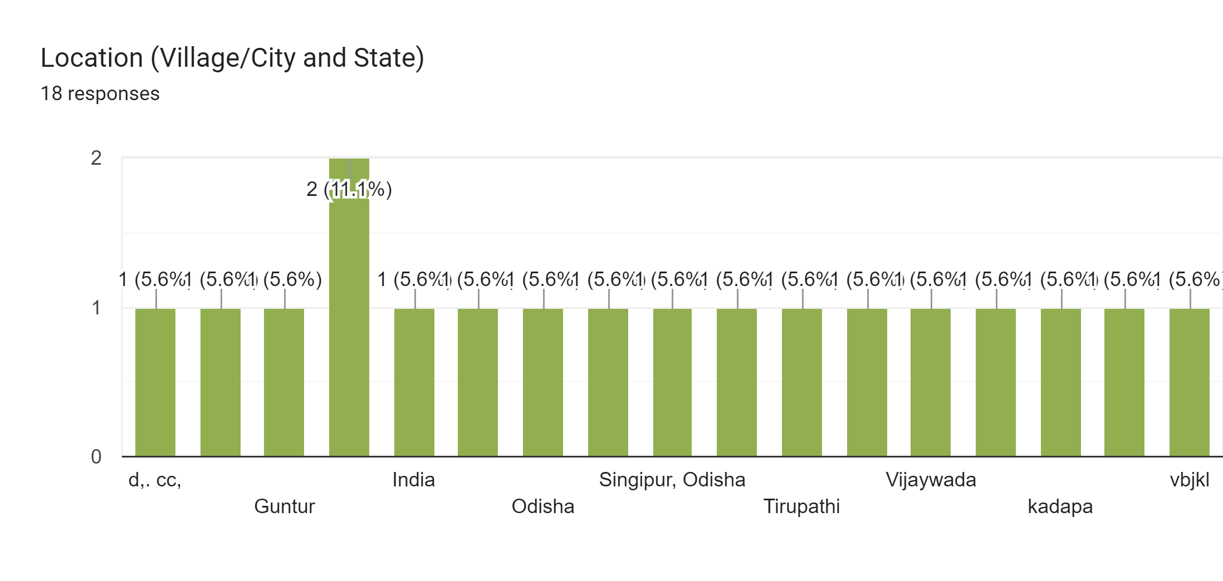
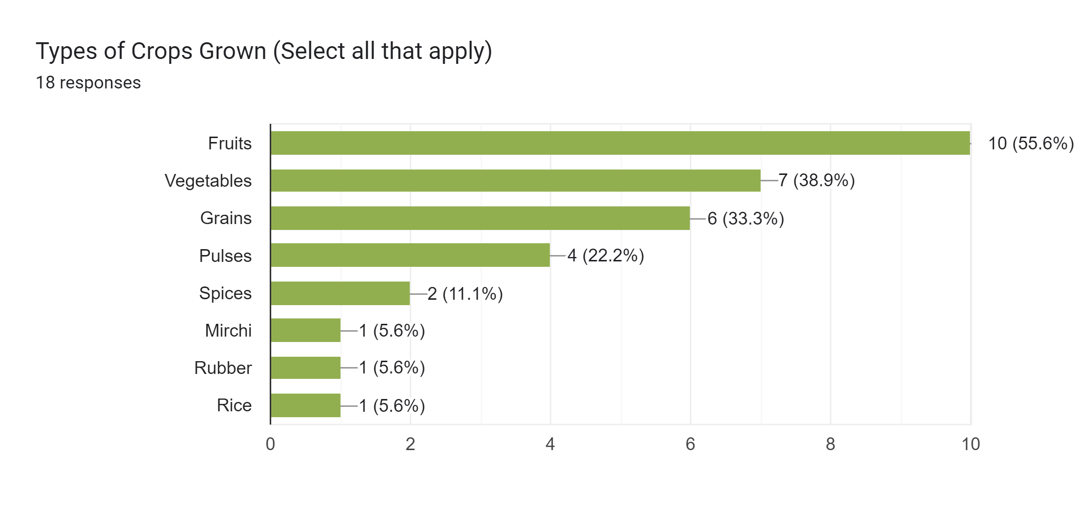
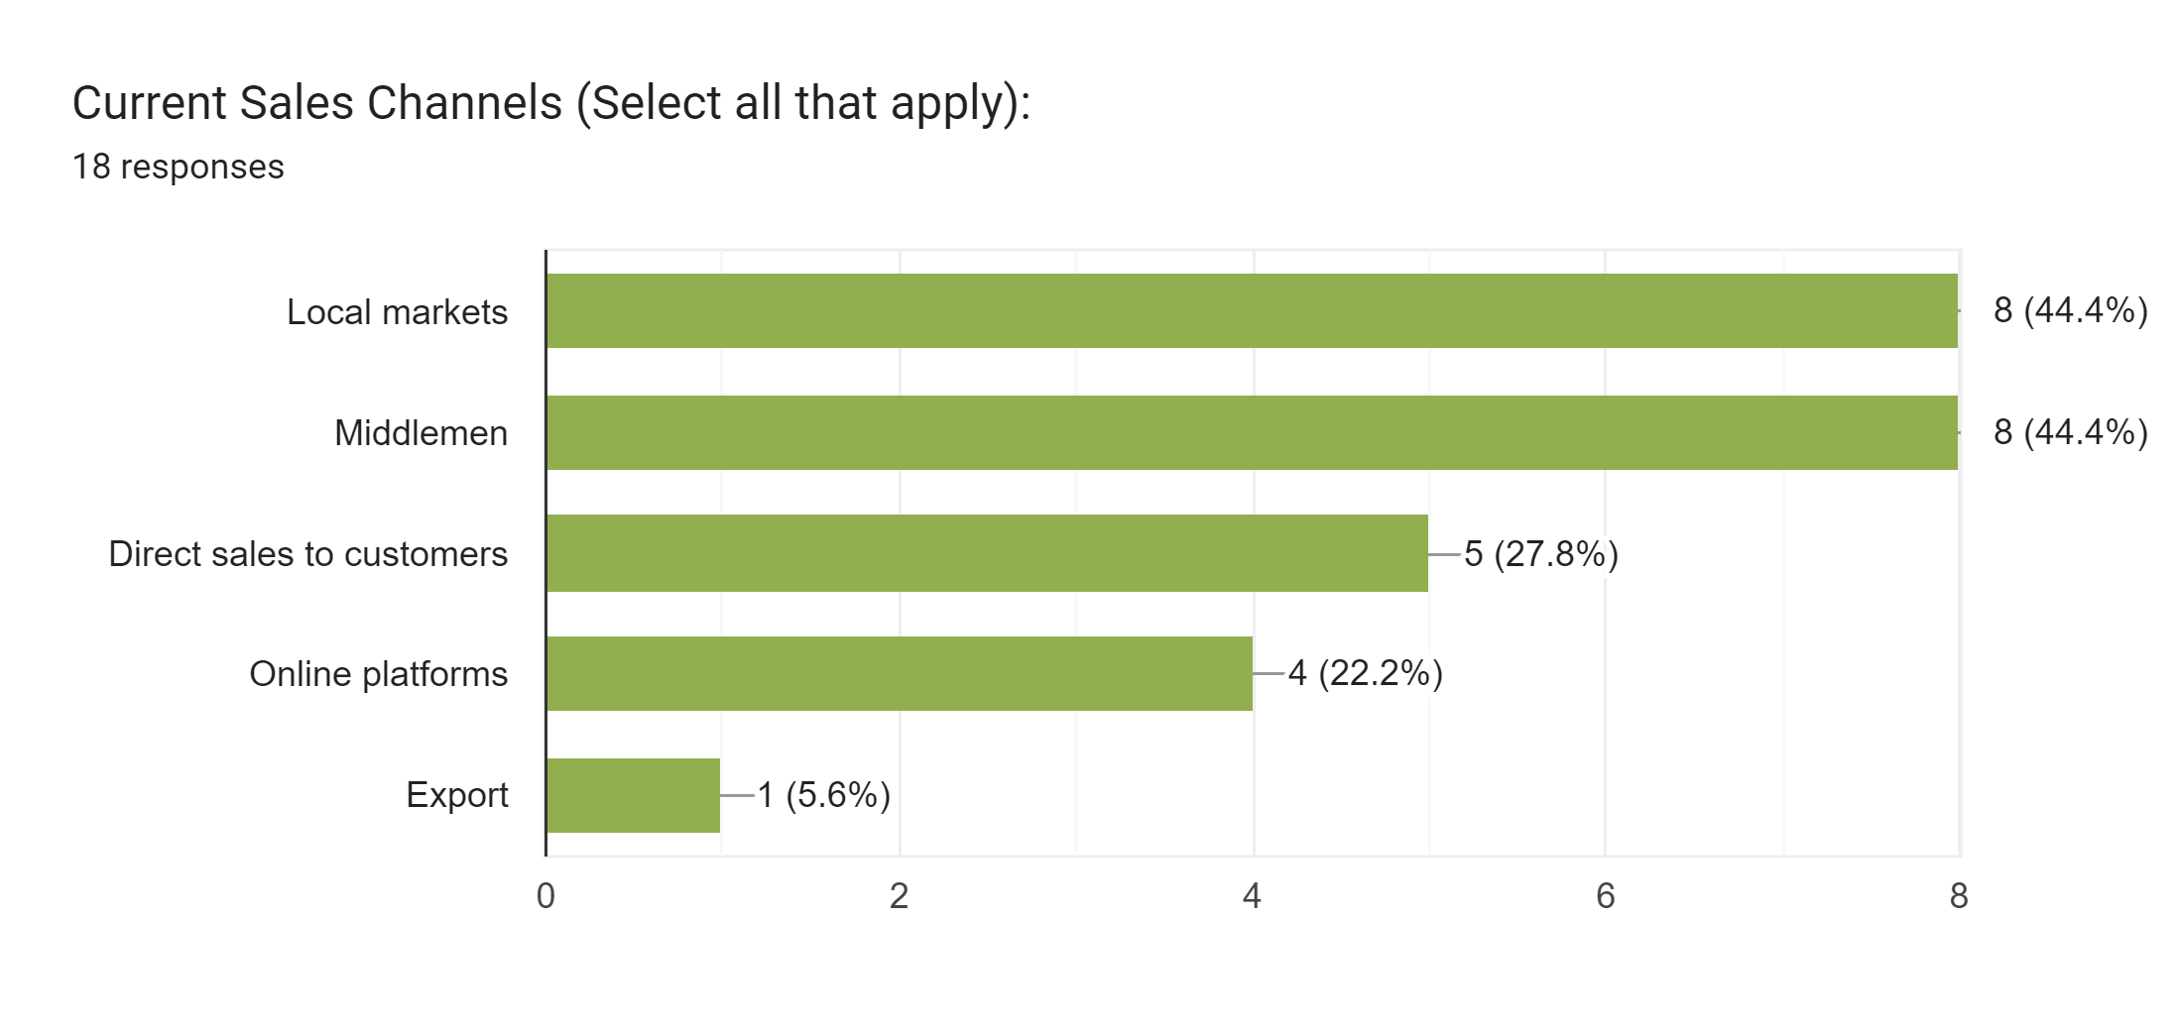
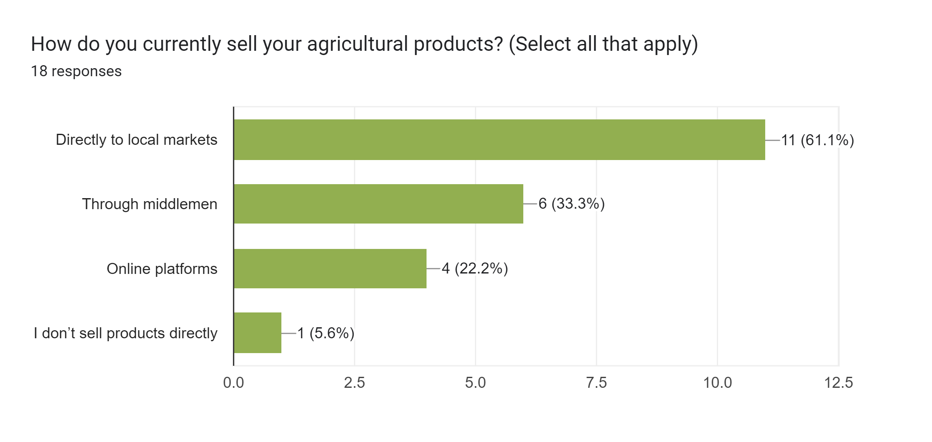

Slide 13
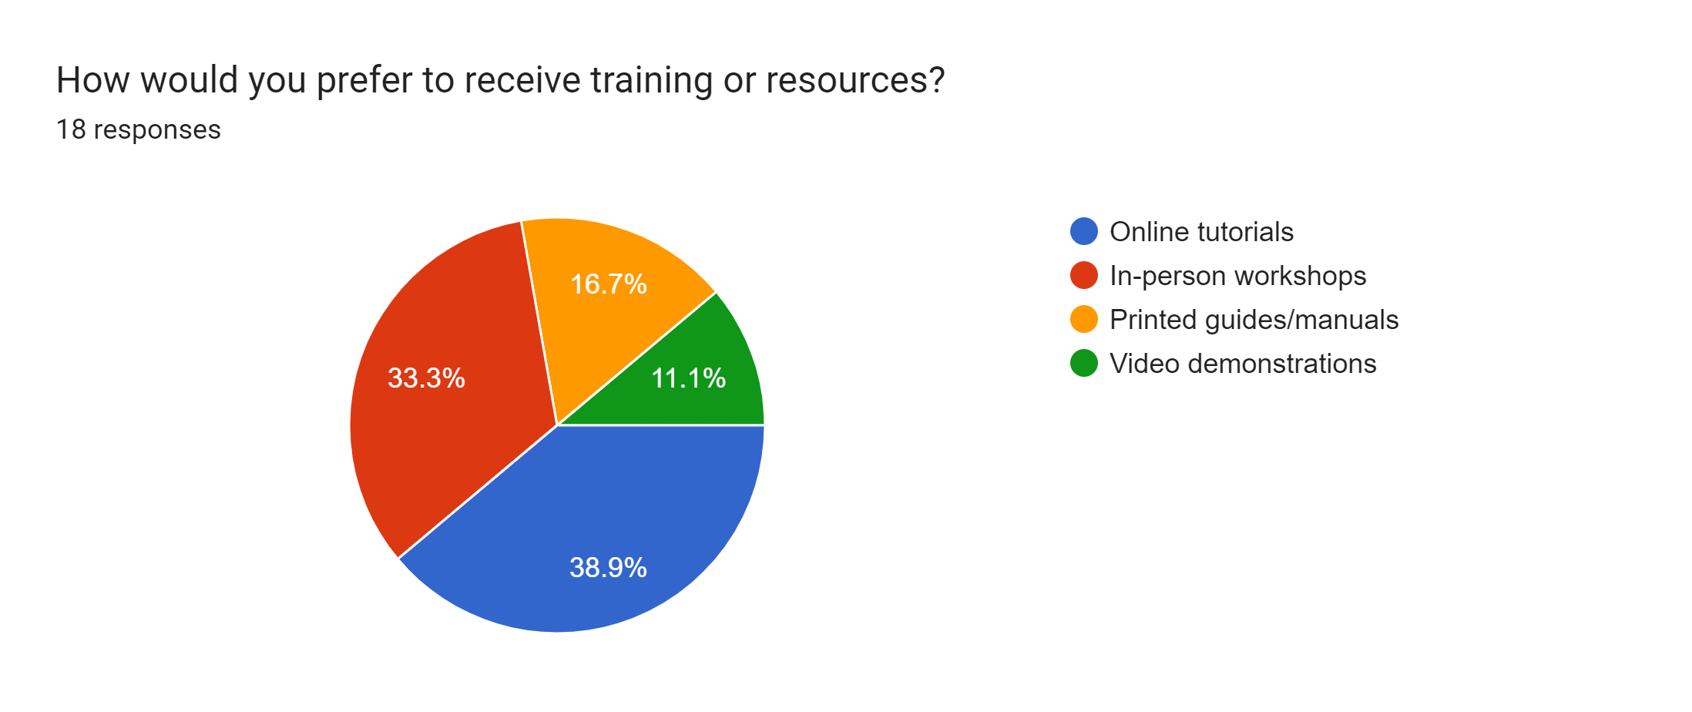
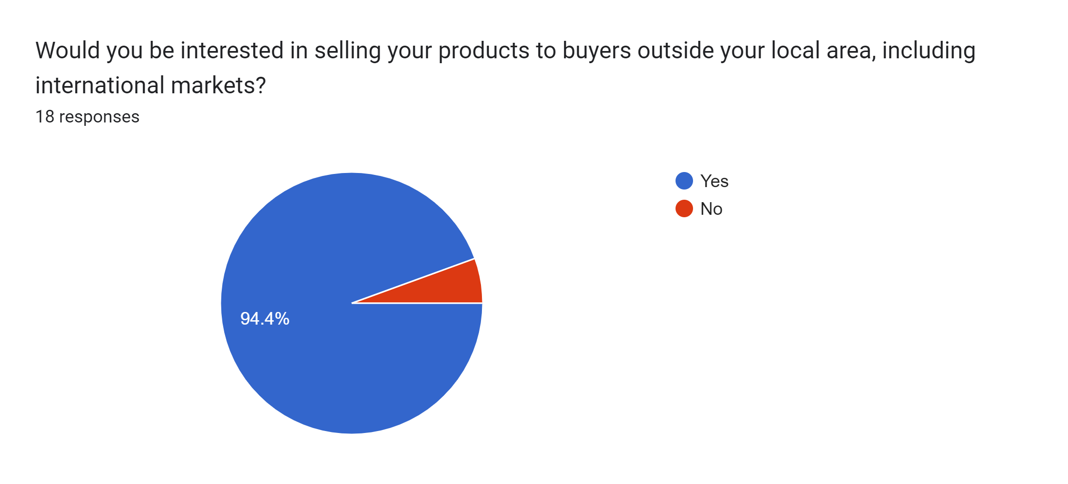
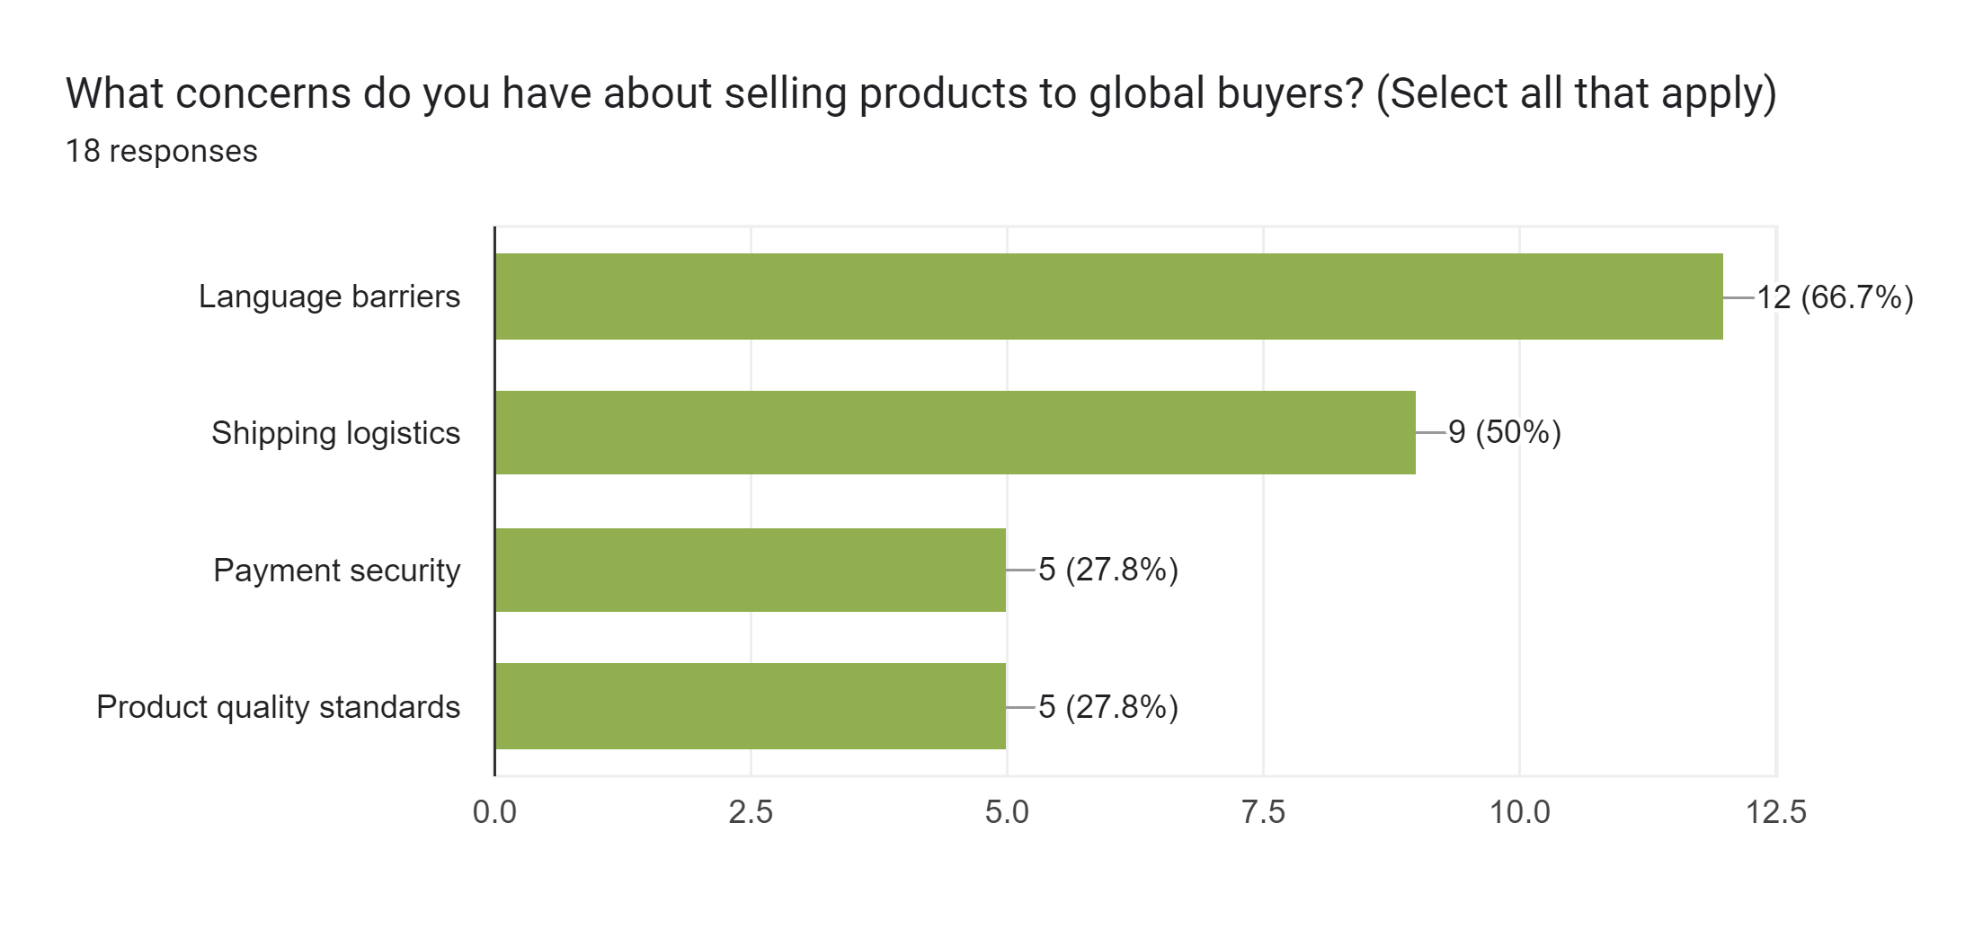
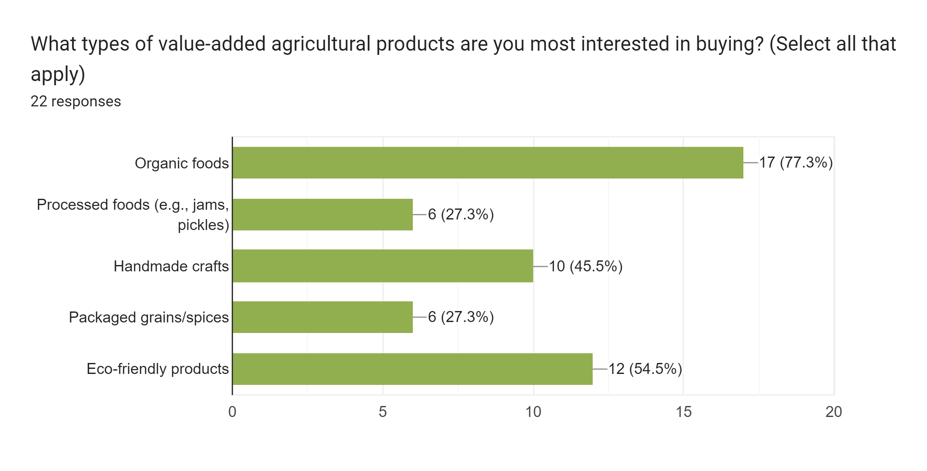

Slide 14
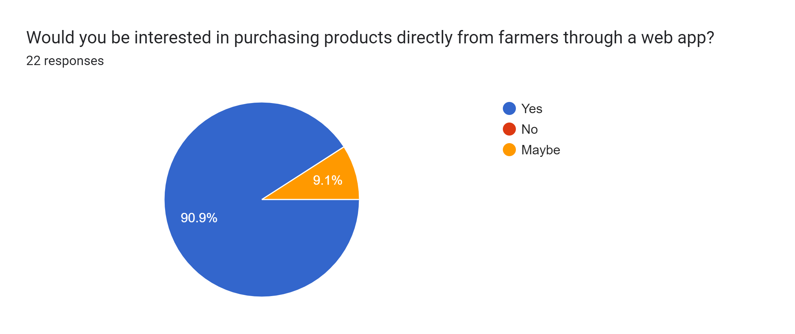
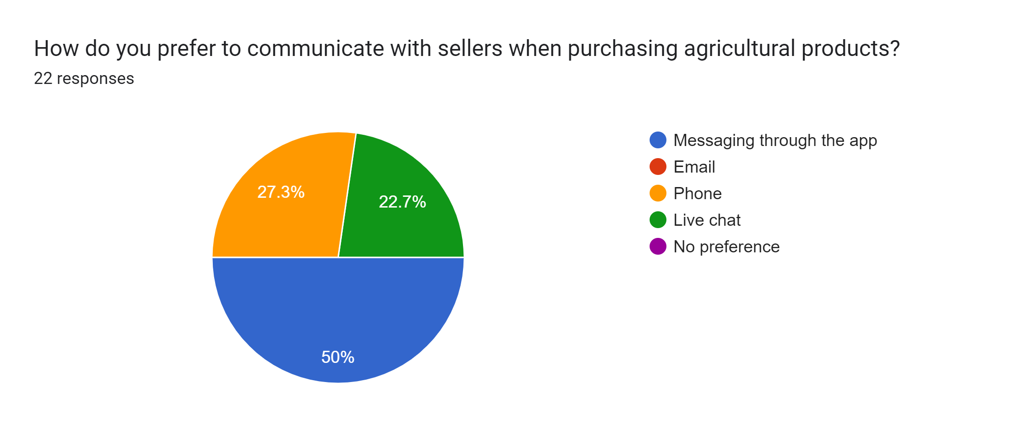

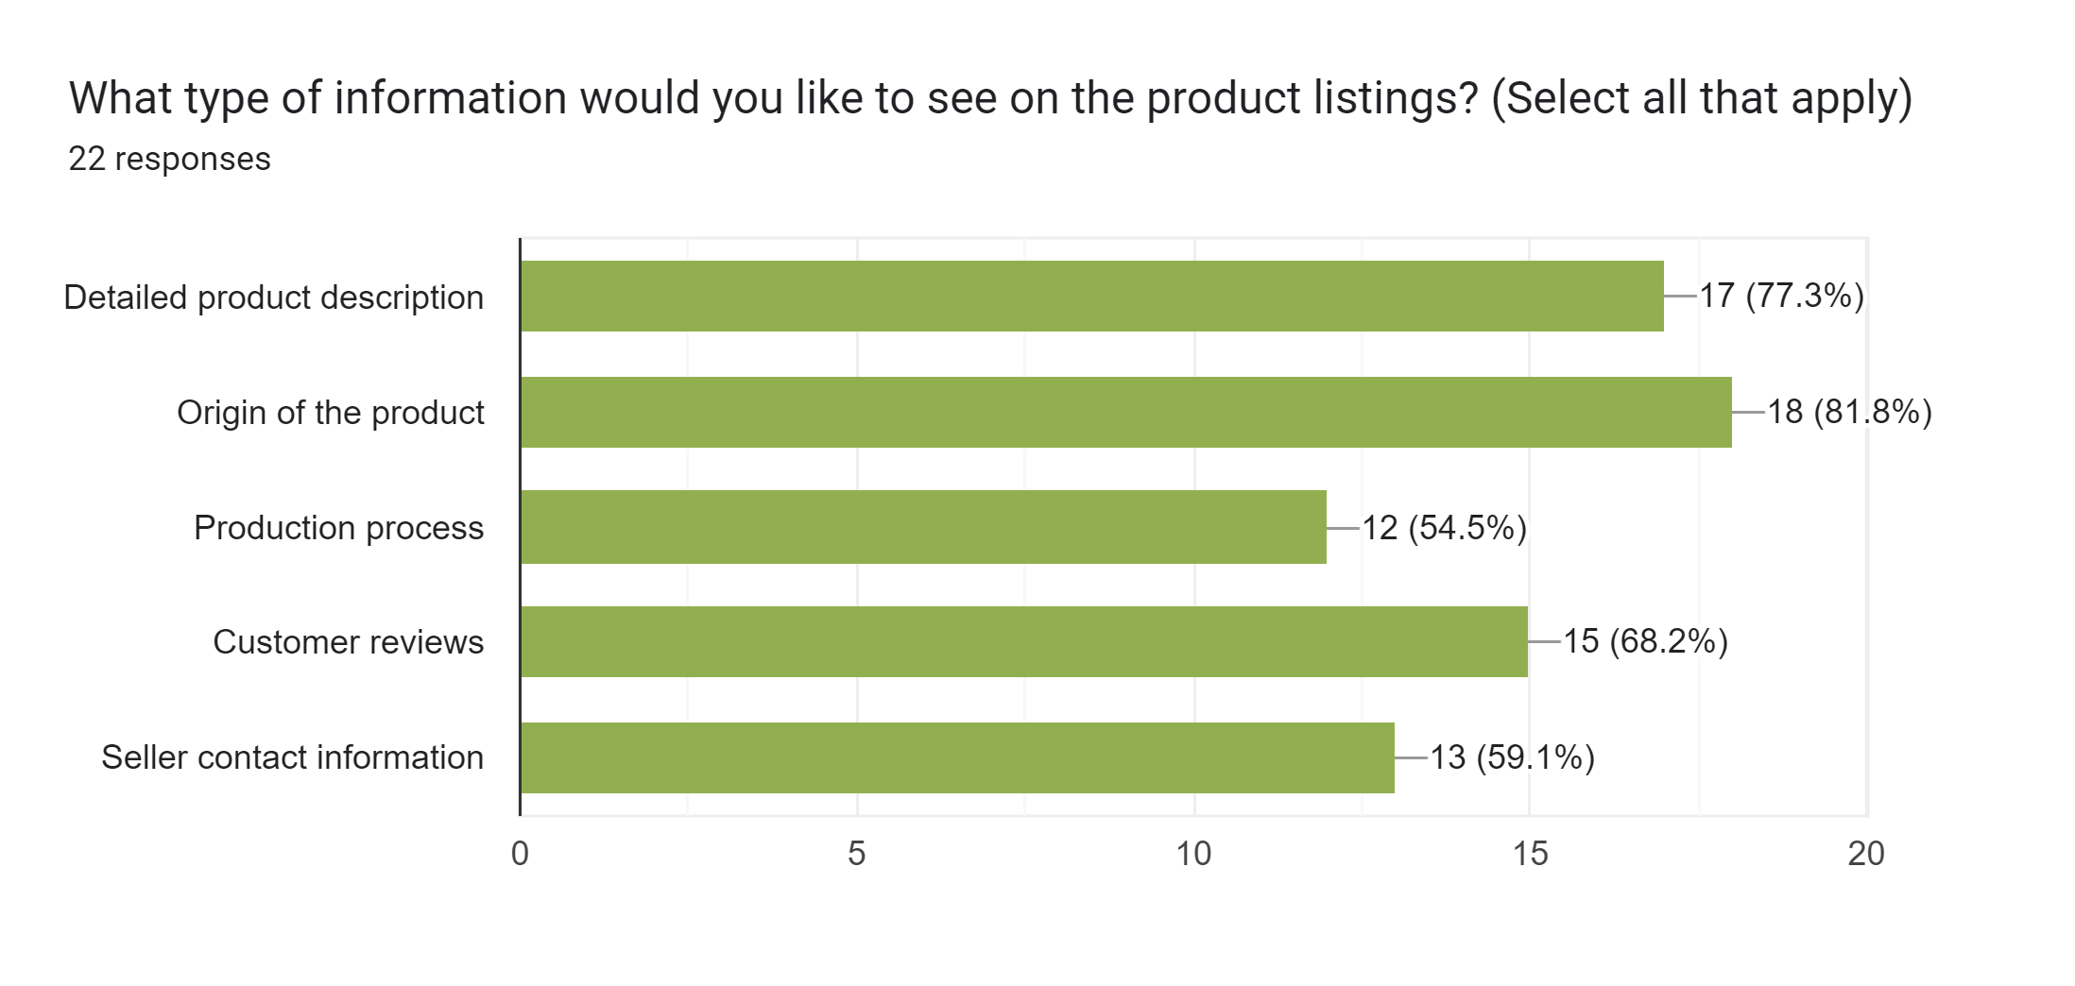

Slide 15





Frameworks and Tools

Slide 16
Conclusion
The web application will empower farmers by helping them expand their business through value-added products, while also creating a seamless buying experience for global consumers. By promoting rural entrepreneurship and supporting the use of technology, this project aims to boost farmer income and promote sustainable agricultural practices.

